Slide 1
Experience day
By Xiting

Slide 2
Fun & useful
Testing policy
Sports
4 Minigames

Slide 3
Testing policy

Slide 5
Compensating game
Grade + Course + EC on your back
Find your mates to complete your ‘compensation group’
E.g.
5,0 (5EC) Productions
7,0 (2EC) Leisure
7,0 (3EC) Prof.L.

Slide 6
FIGURATION GAME
Two members of each group stand with their back to the screen
One other member stands in front of them with his/her face to the screen
Words appear on the screen
The member facing the screen will depict the words on the screen and the duo has to guess what is being depict
Once guessed correctly, all players will rotate clockwise
The team that gets 10 right answers the fastest, wins
The winning team gets 20 ECT’s, second place gets 10 ECT's
NO SPEAKING

Slide 7
GROUP 1

Slide 8
1

Slide 9
SWIMSUIT

Slide 10
2

Slide 11
KARATE

Slide 12
3

Slide 13
PENALTY

Slide 14
4

Slide 15
BASEBALL

Slide 16
5

Slide 17
HELMET

Slide 18
6

Slide 19
FREERUNNING

Slide 20
7

Slide 21
SPORT SHORTS

Slide 22
8

Slide 23
ARCHERY

Slide 24
9

Slide 25
HOCKEY PUCK

Slide 26
10

Slide 27
TENNIS BALL

Slide 28
GROUP 2

Slide 29
1

Slide 30
DARTS

Slide 31
2

Slide 32
BALLROOM

Slide 33
3

Slide 34
HORSEBACK RIDING

Slide 35
4

Slide 36
SKIÏNG

Slide 37
5

Slide 38
WreSTLING

Slide 39
6

Slide 40
BALLET

Slide 41
7

Slide 42
SWIM CAP

Slide 43
8

Slide 44
HOMERUN

Slide 45
9

Slide 46
ICE SKATES

Slide 47
10

Slide 48
YELLOW CARD

Slide 49
The winner gets 20 ECT’s
Second place gets 10 ECT’s

Slide 50
Sports
Combining sport & study
Fellow students
Via school
Discount

Slide 51
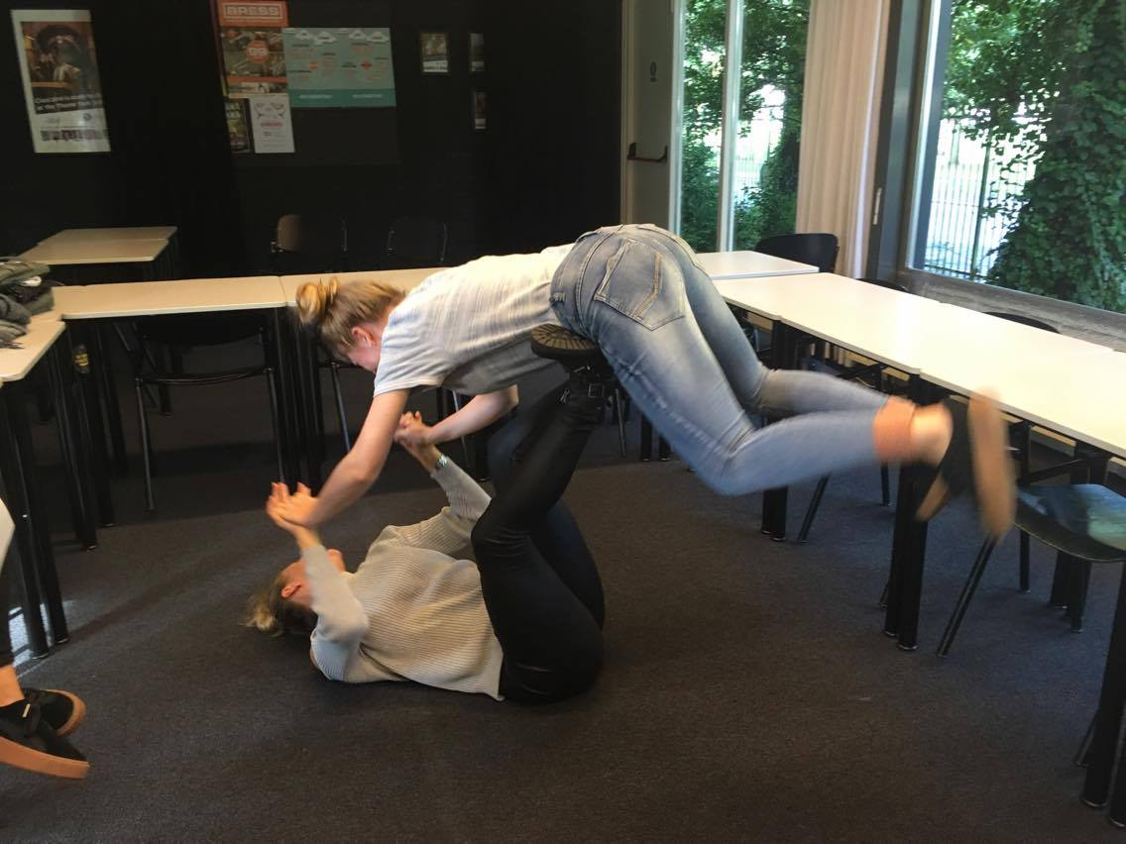
On-the-floor game
On the ground
Give us the elaboration of what we instruct you to do
Different duo each time
E.g.
1 back, 1 ear
The winner gets 20 ECT’s
Second place gets 10 ECT’s

Slide 52
Bomb game
Sit in a circle in the order 1 2 3 1 2 3 etc.
Hold the package when asked a question
Only pass it on to the left when you give a good answer
When the bomb goes off, the game is over
Each good answer is worth 5 ECT’s
If you hold the bomb when it goes off, you loose 20 ECT’s

Slide 53
Fill in the assesment form

